Slide 1
Intro to coding
BLUSH
2017

Slide 2
How does coding work?
Programs are statement driven, you give a command and the computer will store some values/perform an action according to your statement
Examples:
print(“Some string”) will print out whatever is in your parenthesis
x = 5 will create a variable, x, with the value 5

Slide 3
How does coding work?
The program will read from a starting point down line-by-line, until you tell it to jump somewhere else
“Jumping” to another point has been done in different ways throughout history, and is a very important concept in computer science

Slide 4
Some History
In the early days of computing:
Code was written with a flow from top to bottom
Written to be hosted on the programmer’s/software owner’s computer
Computer hardware was a big issue
Many languages became “standard” for certain tasks (HTML, C, Fortran, ML, etcetcetc)

Slide 5
But today?
Not the case!
Object-oriented programming has taken over
Cloud services have become normative
Amazon servers running AWS
So many languages for so many purposes
Mobile: iOS, Android
Desktop: Java, c++, c, python,
Web: javascript, php, python, ruby, java, etcetcetc

Slide 6

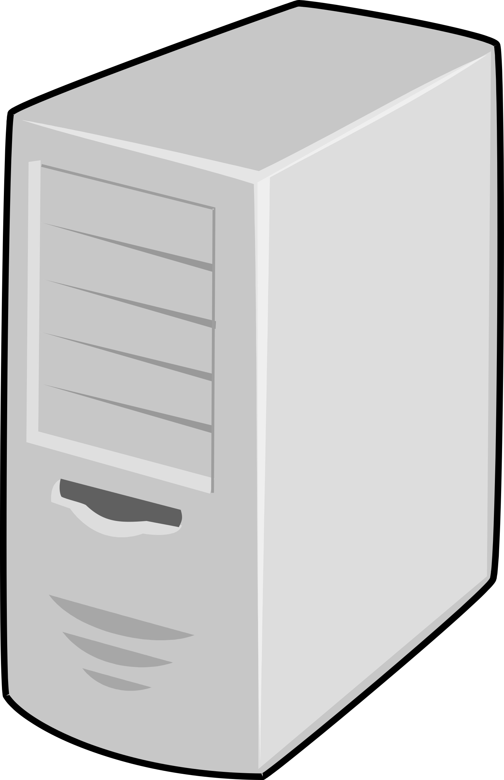
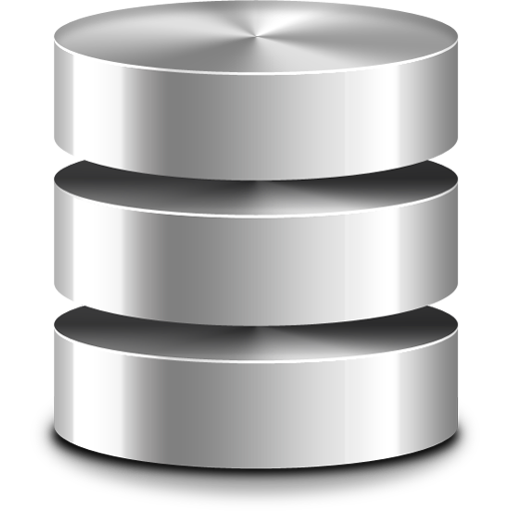
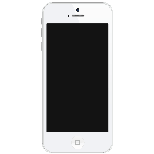
The Stack
Desktop User
Server
Database
Mobile User

Slide 7
The Stack
API
Network
Desktop User
Server
Database
Mobile User

Slide 8
The Stack
API
Network
Desktop User
Mobile API
Mobile Networking
Database
Server
Mobile User

Slide 9
The “Full” Stack
API
Network
Desktop User
Data model
Security
Mobile API
Mobile Networking
Database
Server
Mobile User

Slide 10
Let’s talk jargon
Module vs Program
importing
Object-oriented programming – OOP
Cloud
_____ as a service (SaaS/XaaS)
Open source

